Slide 1
WORKSHOP ON INTERNET OF THINGS 67612 Exercise 3
Detecting the best cellular network around
Prof. David Hay, Dr. Yair Poleg, MR. Samyon Ristov

Slide 2
The Exercise
Part 1
Connect the Cellular Concept Board to the PC
Detect cellular networks and try to register with each one of them
Print the progress & final results of the detection process on the screen
Part 2
Connect the Cellular Concept Board to the MCU
Port your network detection code to the MCU
Print the progress & final results of the detection process on the dev kit’s LCD display

Slide 3
Part 1 – Guidance
Connect the Cellular Concept Board to the PC and make sure it works:
There are two USB ports on the board, use port “ASC0”.
Default baud rate: 115200 (8N1)
Power up the modem by pressing the ‘Start’ button
Wait for the “^SYSSTART” URC* to appear
Send “AT” + enter and see that you get “OK” as a response.
Can’t see what your are typing, but you do get an “OK” response? It’s OK!
No response at all? Start over! (the “Off” button can help)
*URC - unsolicited result code. Not a reply to AT command but some information that can be thrown by the module any time

Slide 4
Part 1 – Guidance cont’d
Enhance your serial wrapper:
Add the following function:
bool SerialSend(unsigned char *buf, unsigned int size);
The serial wrapper should now contain:
bool SerialInit(char* port, unsigned int baud);
unsigned int SerialRecv(unsigned char *buf, unsigned int maxlen, unsigned int timeout_ms);
bool SerialSend(unsigned char *buf, unsigned int size);
void SerialFlushInputBuff (void);
void SerialDisable();
Test your code with the Cellular concept board
E.g.: send “AT\r\n” and receive a response from the modem

Slide 5
Part 1 – Guidance cont’d
Declare the following function in “cellular.h”:
void CellularInit(char *port) Initialize whatever is needed to start working with the cellular modem (e.g. the serial port).
void CellularDisable() Deallocate / close whatever resources CellularInit() allocated.
bool CellularCheckModem(void) Checks if the modem is responding to AT commands. Return true if it does, returns false otherwise.
bool CellularGetRegistrationStatus(int *status) Returns false if the modem did not respond or responded with an error. Returns true if the command was successful and the registration status was obtained from the modem. In that case, the status parameter will be populated with the numeric value of the <regStatus> field of the “+CREG” AT command.
bool CellularGetSignalQuality(int *csq) Returns false if the modem did not respond or responded with an error (note, CSQ=99 is also an error!) Returns true if the command was successful and the signal quality was obtained from the modem. In that case, the csq parameter will be populated with the numeric value between -113dBm and -51dBm.

Slide 6
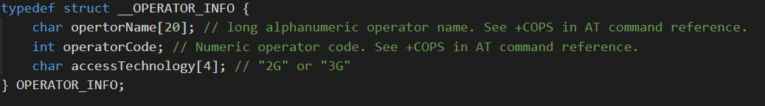
Part 1 – Guidance cont’d
….more declarations in “cellular.h” :
bool CellularSetOperator(int mode, char *operatorName) Forces the modem to register/deregister with a network. Returns true if the command was successful, returns false otherwise. If mode=0, sets the modem to automatically register with an operator (ignores the operatorName parameter). If mode=1, forces the modem to work with a specific operator, given in operatorName. If mode=2, deregisters from the network (ignores the operatorName parameter). See the “+COPS=<mode>,…” command for more details.
bool CellularGetOperators(OPERATOR_INFO *opList, int maxops, int *numOpsFound) Forces the modem to search for available operators (see “+COPS=?” command). Returns false if an error occurred or no operators found. Returns true and populates opList and opsFound if the command succeeded. opList is a pointer to the first item of an array of type CELLULAR_OP_INFO, which is allocated by the caller of this function. The array contains a total of maxops items. numOpsFound is allocated by the caller and will contain the number of operators found and populated into the opList.

Slide 7
Part 1 – Guidance cont’d
Create a program (main.c) that performs the following sequence:
Initialize the cellular modems.
Makes sure it’s responding to AT commands.
Finds all available cellular operators.
Tries to register with each one of them (one at a time).
If registered successfully, it prints the signal quality.
Print the program’s progress all along (e.g. “Checking modem…the modem is ready!” etc.)
Tips:
Try everything manually (e.g. using putty/hyperterm/terraterm etc) before writing a single line of code.
The AT command reference is your friend.
Not all AT commands born equal! Some will return in a second, others will take minutes to complete.
Invest a good AT command builder/parser. It will save you time.
Your SIM cards are limited to 5MB. Any additional byte above 5MB equals -1 point in the final score.

Slide 8
Part 2 – Guidance
Port your code from the PC to the dev kit.
This time we’ll need three wires: RX, TX, GND.
Note: these are not just wires!
The previous exercise used the LEUART peripheral. This time, we are using one of the USART peripherals.
We are using it in an Asynchronous mode, so it’s a UART, not USART.
You can modify your LEUART code to work with the USART. Most function calls are the same.
You might need to impalement a USART receive interrupt handler.
Display all the information nicely on the LCD screen.
Bonus (10 points): implement line scrolling on the LCD screen.

Slide 9
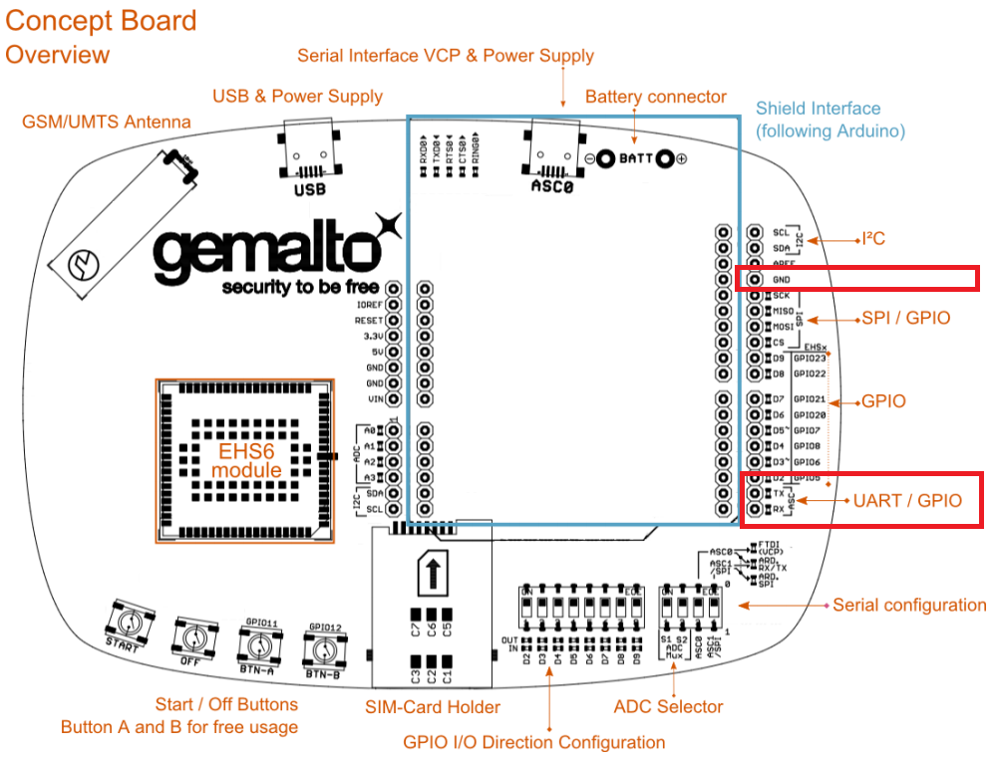
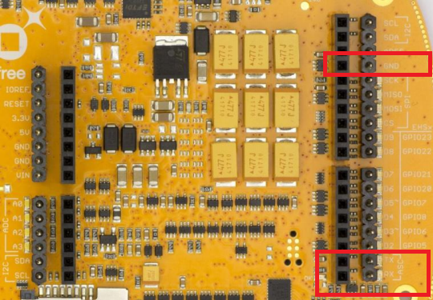
Part 2 – Guidance cont’d
Read the Cinterion Concept Board Hardware Interface Description and Cinterion Concept Board Start-up Guide and find the right pins. Be careful – connection to the wrong pins can kill the hardware.

Slide 10
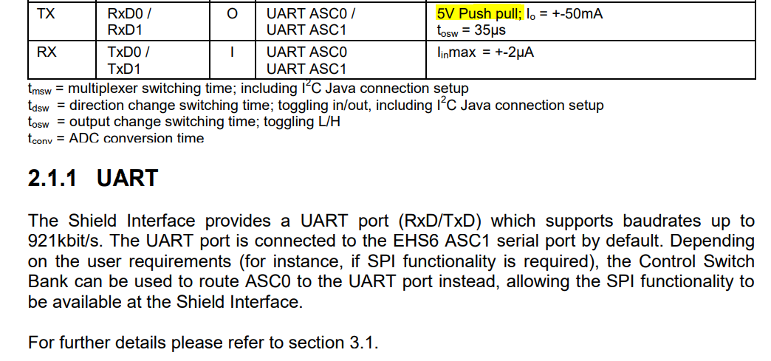
Part 2 – Guidance cont’d

Slide 11
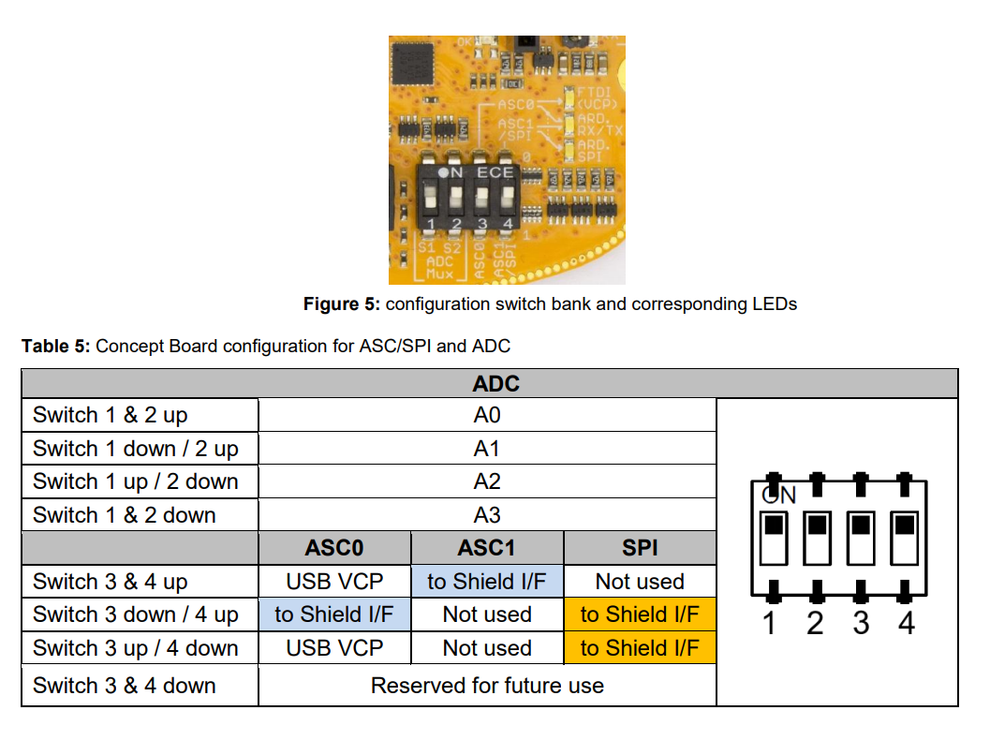
Part 2 – Guidance cont’d
PC Mode
MCU Mode

Slide 12
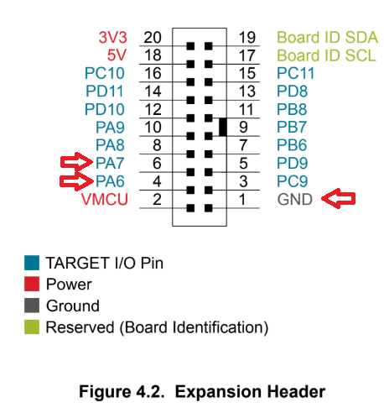
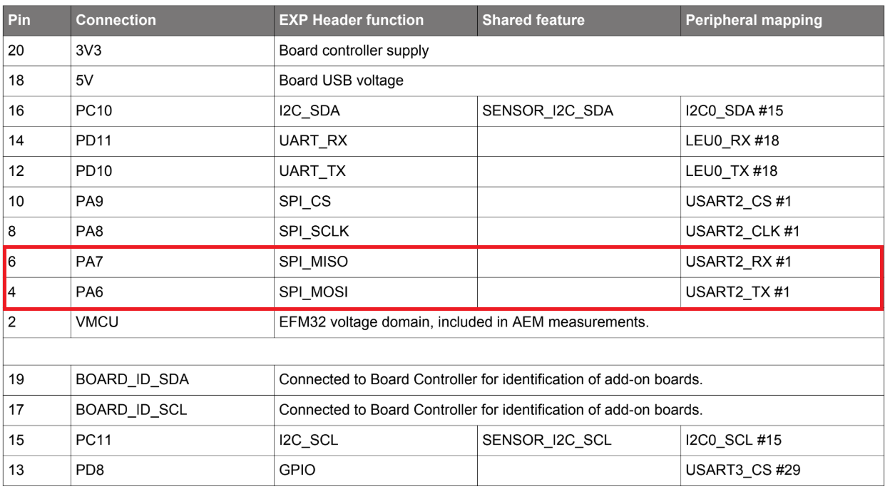
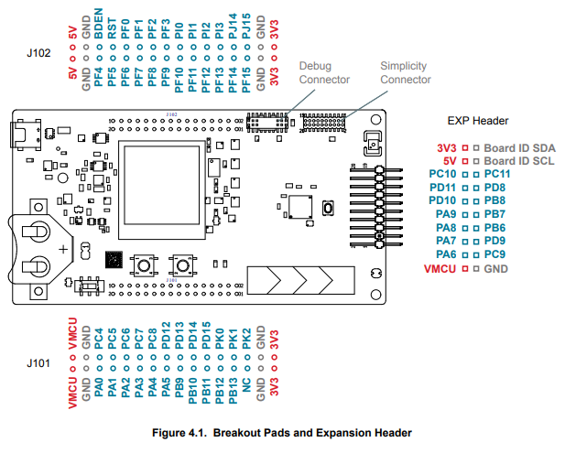
Part 2 – Guidance cont’d
Read the EFM32 Pearl Gecko Starter Kit User's Guide and find the right pins. Be careful – connection to the wrong pins can kill the hardware.

Slide 13
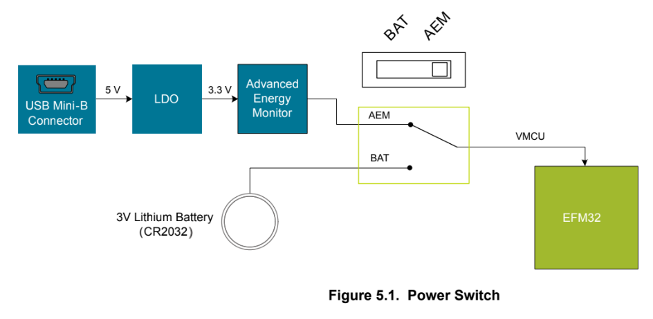
Part 2 – Guidance cont’d

Slide 14
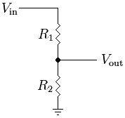
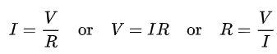
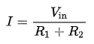
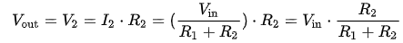
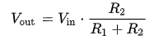
Part 2 – Guidance cont’d
Modem TX (5V) STK RX (3.3V)
A voltage divider is needed.
A voltage divider is a passive linear circuit that produces an output voltage (Vout) that is a fraction of its input voltage (Vin). Voltage division is the result of distributing the input voltage among the components of the divider.
Ohms law:
In our circuit, the current between Vin and GND is:
So the voltage between Vout and GND is:
In short:

Slide 15
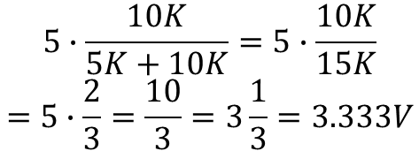
Part 2 – Guidance cont’d
Modem TX (5V) STK RX (3.3V)
Gemalto Modem
STK
R1 5KΩ
TX
RX (PA7)
$$5∙\frac{10K}{5K+10K}=5∙\frac{10K}{15K}$$
$$=5∙\frac{2}{3}=\frac{10}{3}=3\frac{1}{3}=3.333V$$
R2
10KΩ
GND
GND

Slide 16
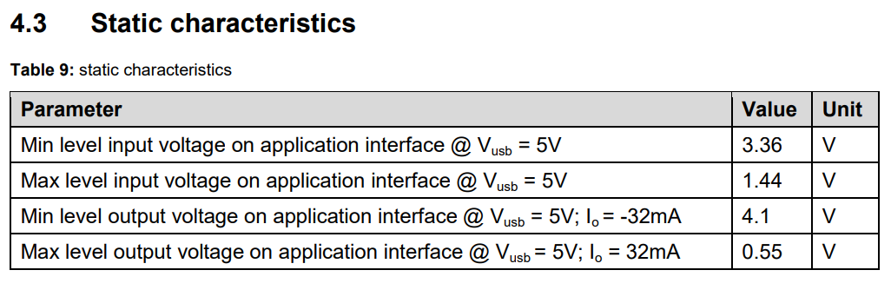
Part 2 – Guidance cont’d
Modem RX (5V) STK TX (3.3V)
3.36V is needed to received a signal… we got 3.3V.
Let’s just connect it and see if it works!

Slide 17
Part 2 – Guidance cont’d
Gemalto
Modem
STK
R1 5KΩ
TX
RX (PA7)
R2
10KΩ
GND
GND
R3 1KΩ
RX
TX (PA6)

Slide 18
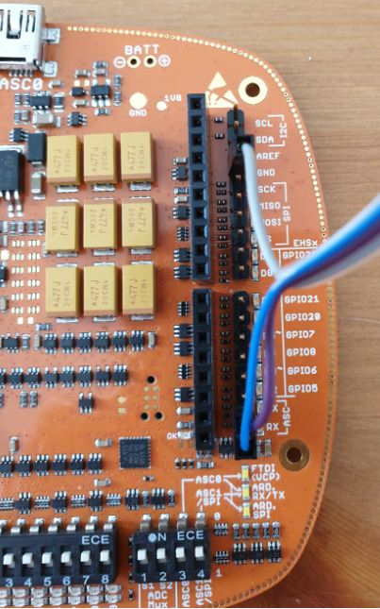
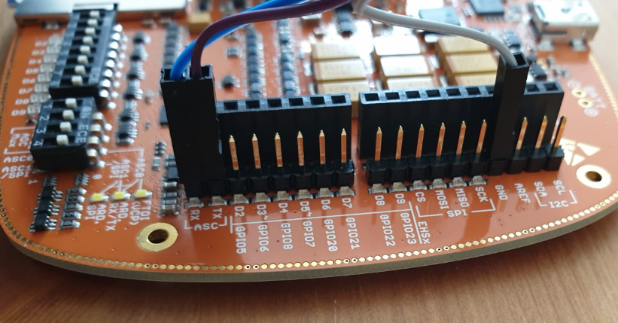
Part 2 – Guidance cont’d

Slide 19
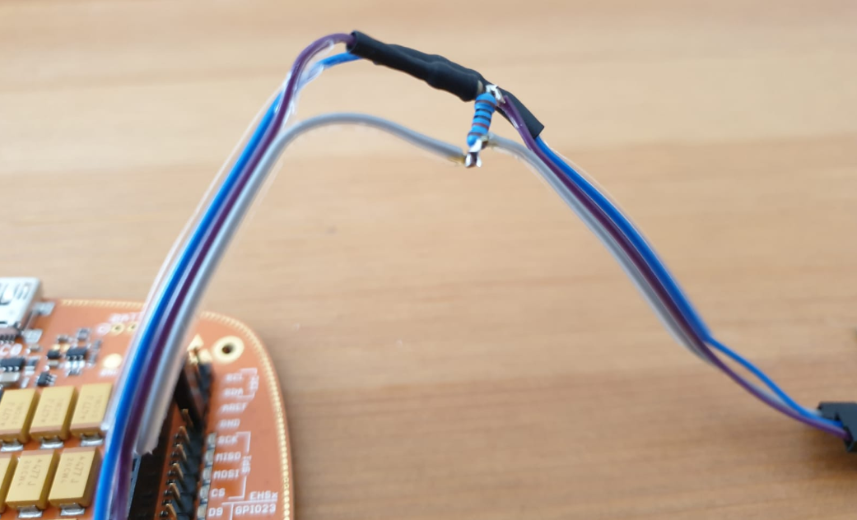
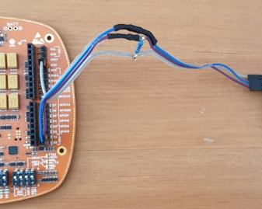
Part 2 – Guidance cont’d

Slide 20
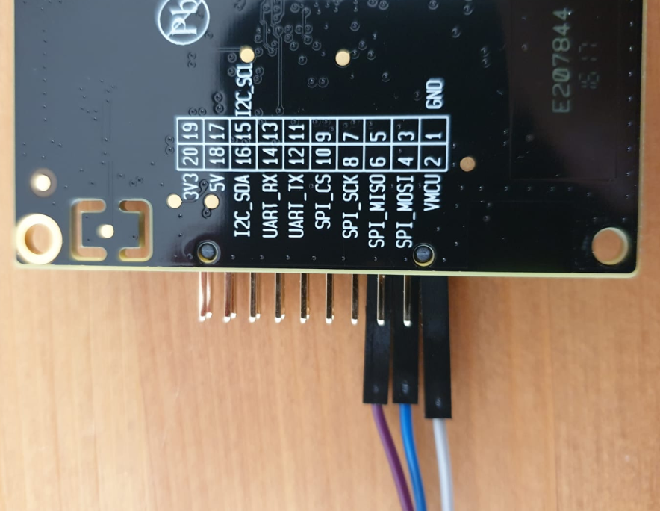
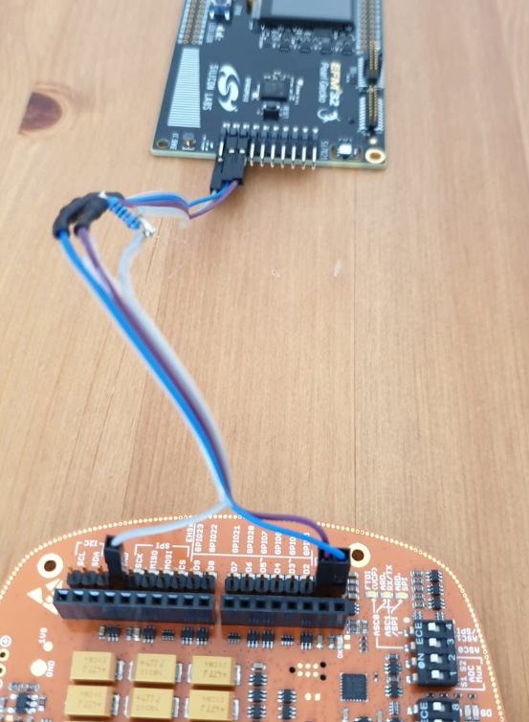
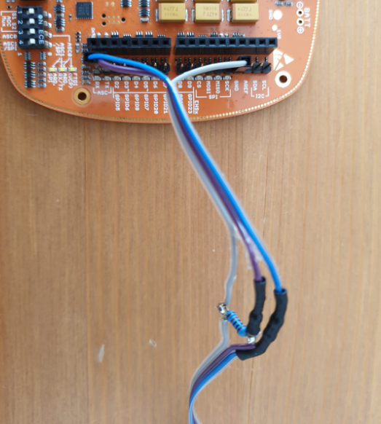
Part 2 – Guidance cont’d

Slide 21
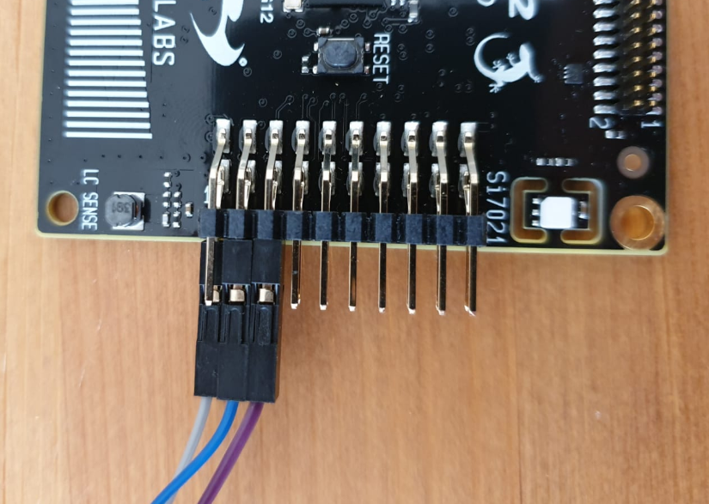
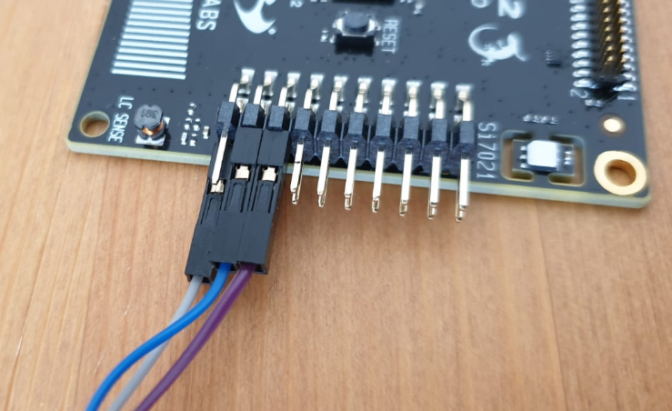
Part 2 – Guidance cont’d

Slide 22
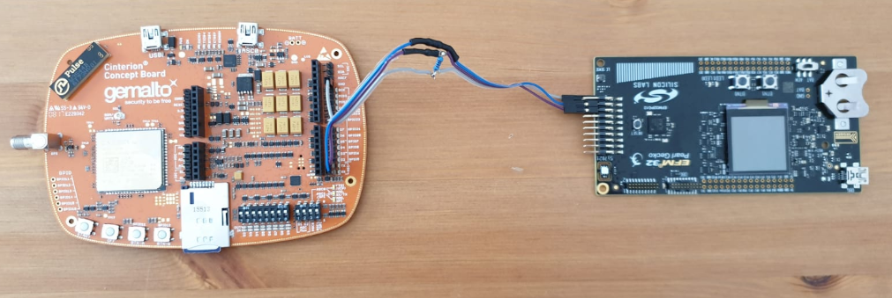
Part 2 – Guidance cont’d

Slide 23
Exercise #3
Work & submit in pairs
Deliverables:
Part 1
Provide all the project files, and/or export the project
Add to the README a detailed compilation instructions and environment (Linux/Widnows, compiler etc.) description. Provide Make file or any other relevant files that are needed to compile the project. We want to be able to compile your project as you do, so we need all the information possible.
Part 2
Export and submit the protect (.sls file)
Compile and submit the .bin file
A README file with your names, email addresses, IDs and adequate level of documentation of the deliverables
Pack all the deliverables as .zip or .rar and upload to Moodle
Deadline: 8.5.19, 10am
The grade will be based on code’s functionality and clear implementation

Slide 24
Contact
Moodle’s ‘Workshop Discussions’ forum is the best place for questions.
But if needed, contact us personally:
David Hay – dhay@cs.huji.ac.il
Yair Poleg – yair.poleg@mail.huji.ac.il
Samyon Ristov – samyon.ristov@mail.huji.ac.il

